Slide 1
Quiz results ON THESE RESULTS THE WRAY IS CLEARLY THE BEST OF THE 50mm/2” LENSES THE XPRES IS BEST OVERALL WITH AN UNBELIVEABLE PERFORMANCE FOR A LENS COVERING 6x9cm
A is the f2.0 TTH for the REID
B is the f2.0 ROSS XTRALUX
C is the f3.8 ROSS XPRES for the ENSIGN
D is the f1.9 DALLMEYER for the WITNESS
E IS THE F2.0 LENS for the WRAYFLEX

Slide 2
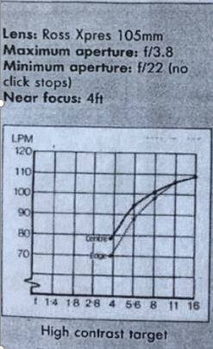
THE “AUTORANGE 820” ROSS XPRES LENS
A.P. RETRO TEST RESULT 1990
ROSS ENSIGN CLAIMED THAT THIS NEW COMPUTATION WITH RACK & PINION FOCUSSING RATHER THAN THE USUAL “FRONT CELL” FOCUSSING GAVE EXCEPTIONAL PERFORMANCE.
GIVEN THESE RESULTS THIS APPEARS TO BE AN UNDERSTATEMENT AS ON THESE RESULTS IT OUT-PERFORMS ALL CONTEMPORARY LENSES FOR THE 24x36mm FORMAT.
DETAILS OF THE LENS DESIGN NEVER APPEAR TO HAVE BEEN PUBLISHED- IT RESEMBLES ALL OTHER 105mm ROSS XPRES LENSES HOWEVER-
AN UNCONFIRMED REPORT FROM INDIA (WHERE ENSIGN ONCE HAD A FACTORY) STATES IT WAS A COLOR-HELIAR TYPE DESIGN WITH FIVE ELEMENTS ?

